Slide 1
ENGLISH GRADE SIX WORD CLASSES
PARTS OF SPEECH

Slide 2
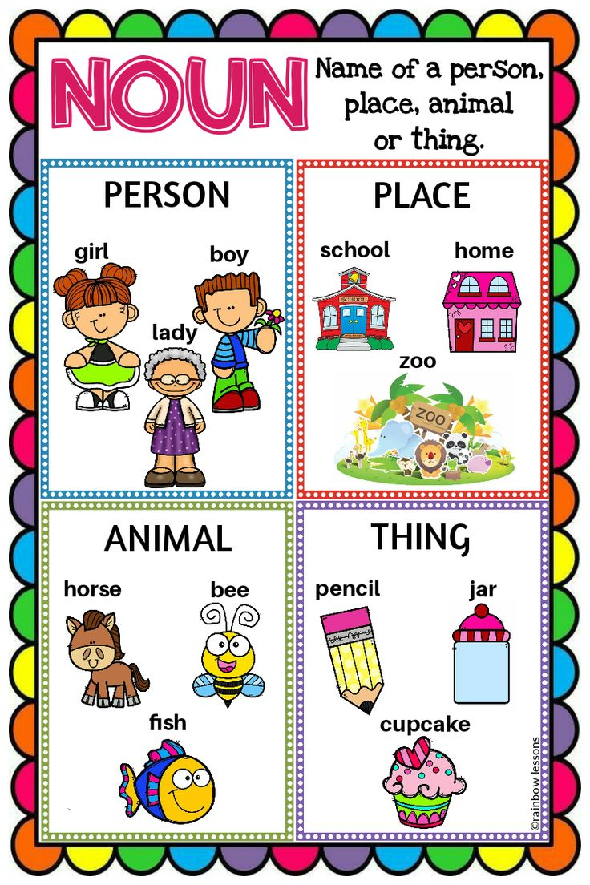
NOUNS
Refers to the name of a person, place, thing or idea. Example: Daniel, London, Table, Hope.
“Mary uses a blue pen for her notes.”
LINK FOR NOUNS:
https://www.youtube .com/watch?v=JHroOYO1i6c

Slide 3
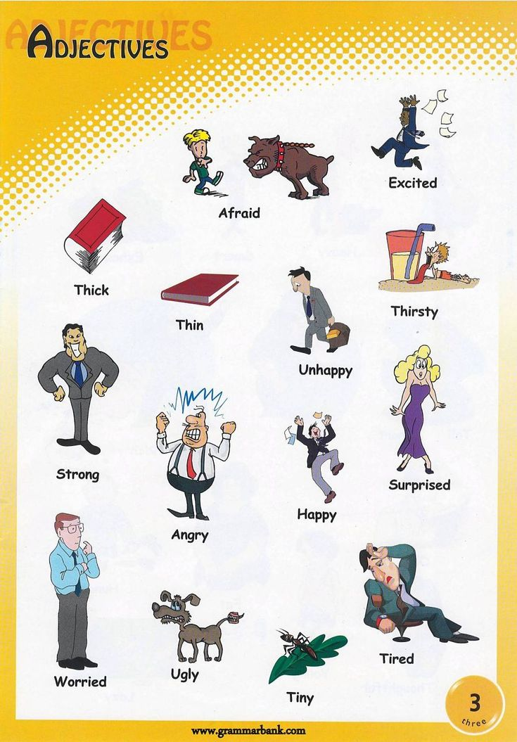
ADJECTIVES
These are words that describe modify or give more information about a noun or pronoun Examples: cold, happy, young, two, fun.
“The little girl has a pink hat”
LINK FOR ADJECTIVE VIDEOS https://www.youtube .com/watch?v=ZzvQj3pEwbc

Slide 4
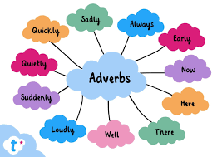
ADVERB
It modifies a verb, an adjective, or another adverb. It tells how (often), where and when.
Example: slowly, very, always, well, too
“Yesterday I ate my lunch quickly.”
ADJECTIVE VIDEO
https://www.youtube .com/watch?v=ZzvQj3pEwbc

Slide 5
CONJUNCTION
They join two words, ideas, phrases together and show how they are connected
Examples: and, or, but, because, yet, so
“I was hungry and tired but I still finished the job.”
Conjunction video
https://www.youtube .com/watch?v=mkDc5Z6P5v0

Slide 6
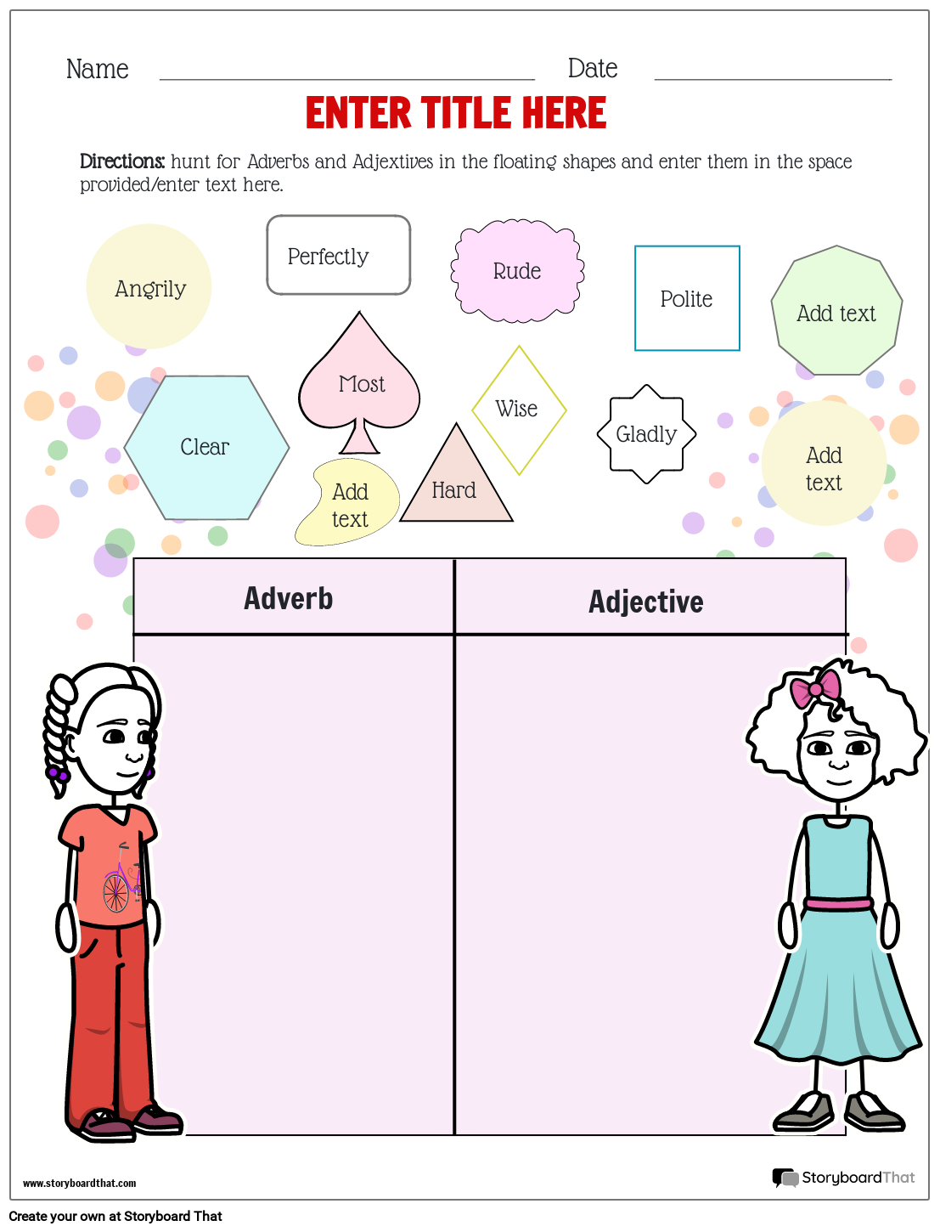
PRACTICAL ACTIVITIES
Which word is an adjective (happy, slowly)

